Slide 1
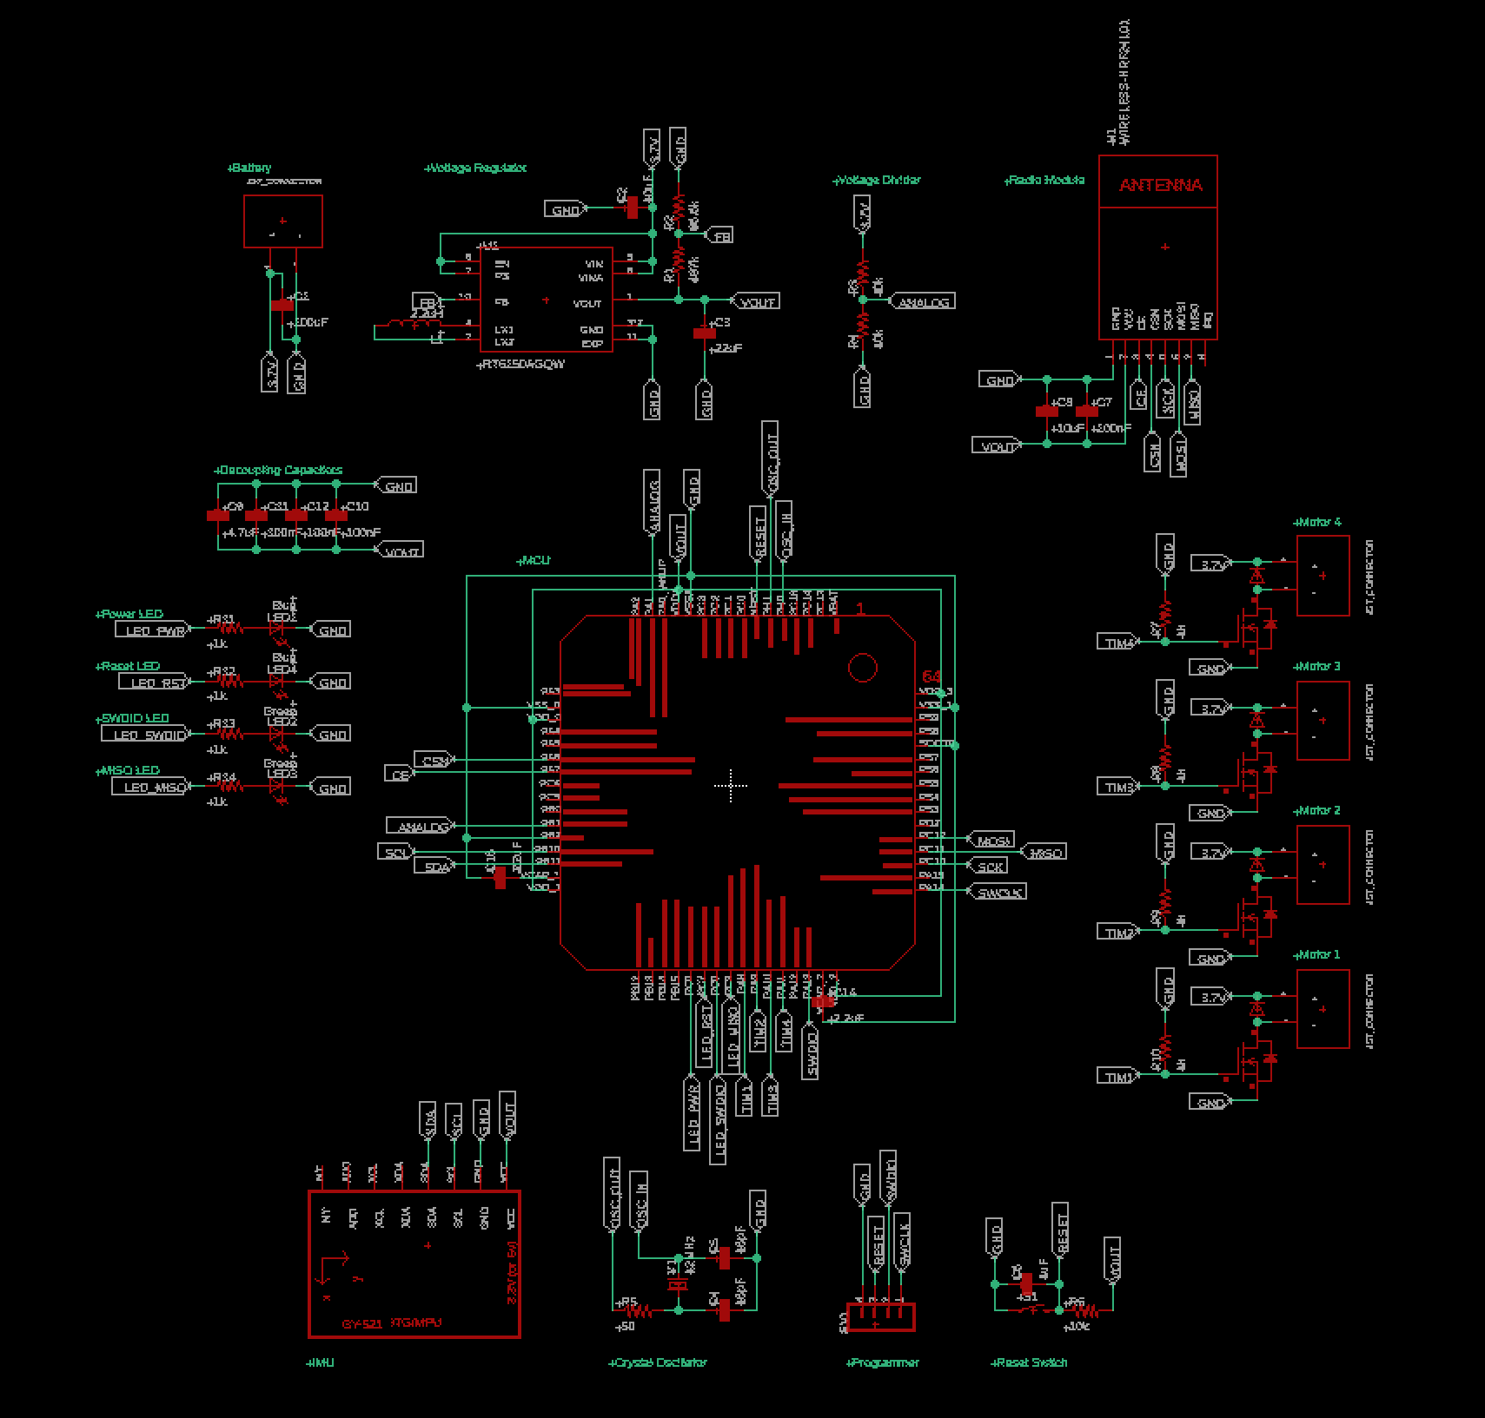
Design Review
Team #6

Slide 2
Parts
Battery: 3.7 Volts
Voltage divider
Radio module: NRF24L01p
IMU: MPU6050
Motor driver (x4)
MCU: STM32F405RGT6
Programmer
Oscillator/resonator: ABLS-12.000MHZ-B2-T
Voltage regulator
Decoupling capacitors
Reset switch

Slide 3
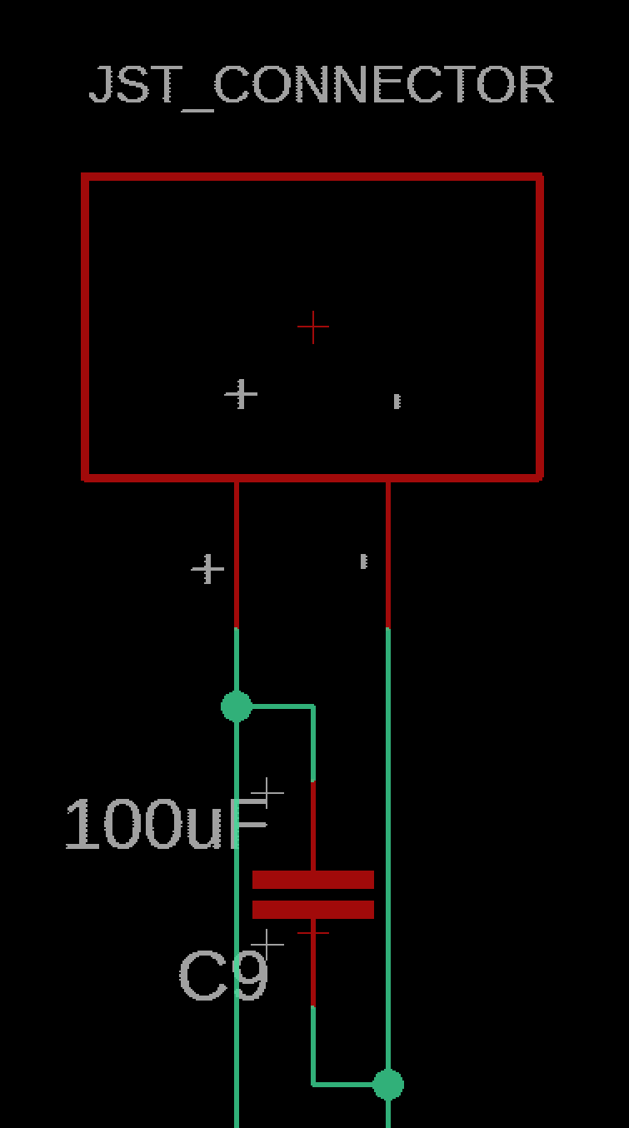
Battery
3.7 V
100 uF Decoupling Capacitor

Slide 4
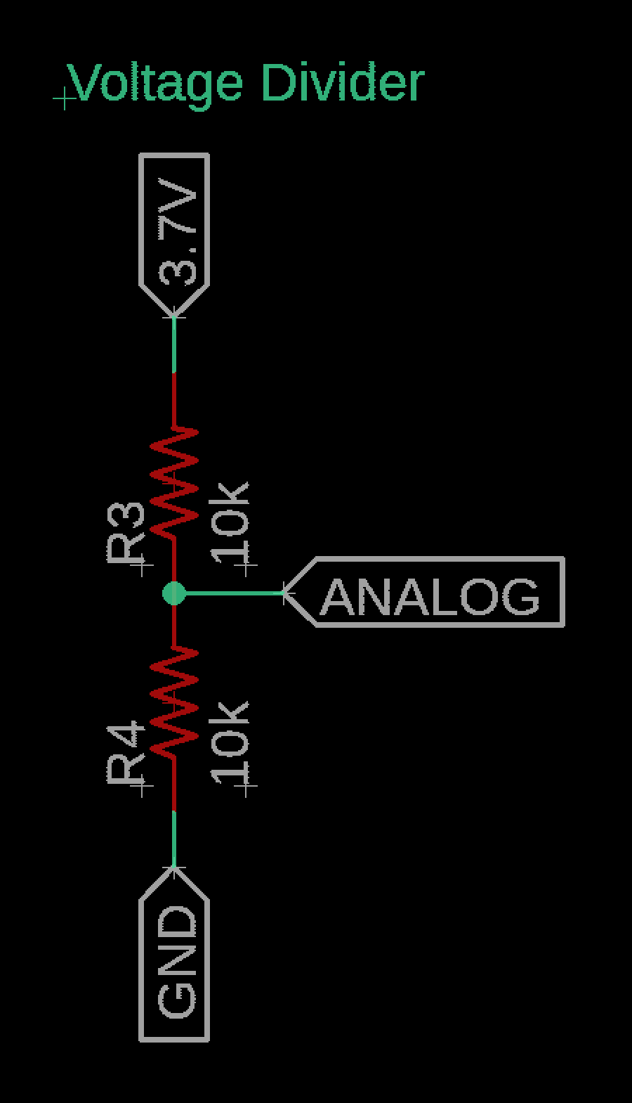
Voltage Divider
Resistors: 10kOhm (x2)
Attached to an analog pin
Receives power from the battery

Slide 5
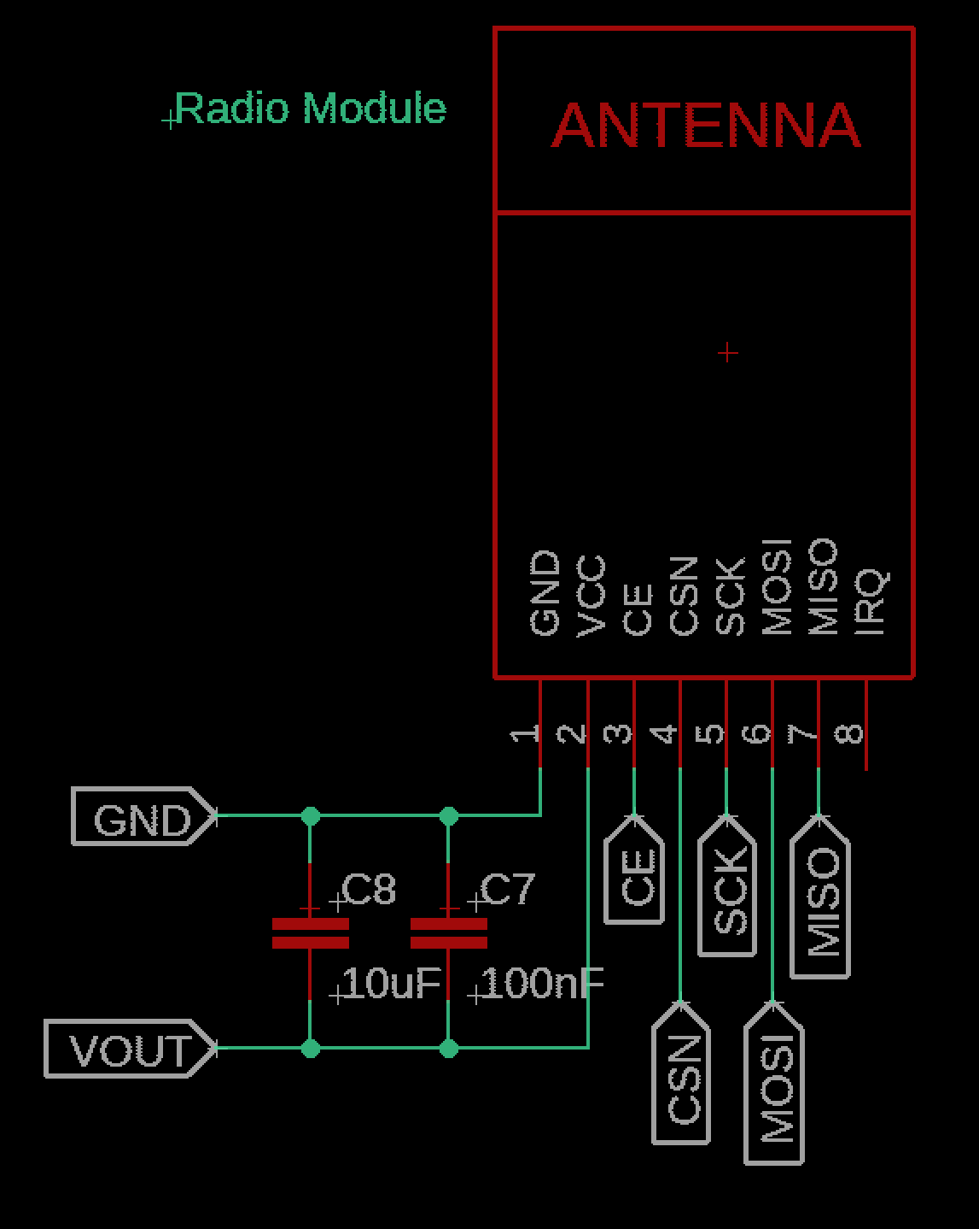
Radio Module
NRF24L01p
Decoupling Capacitors: 10uF, 100nF

Slide 6
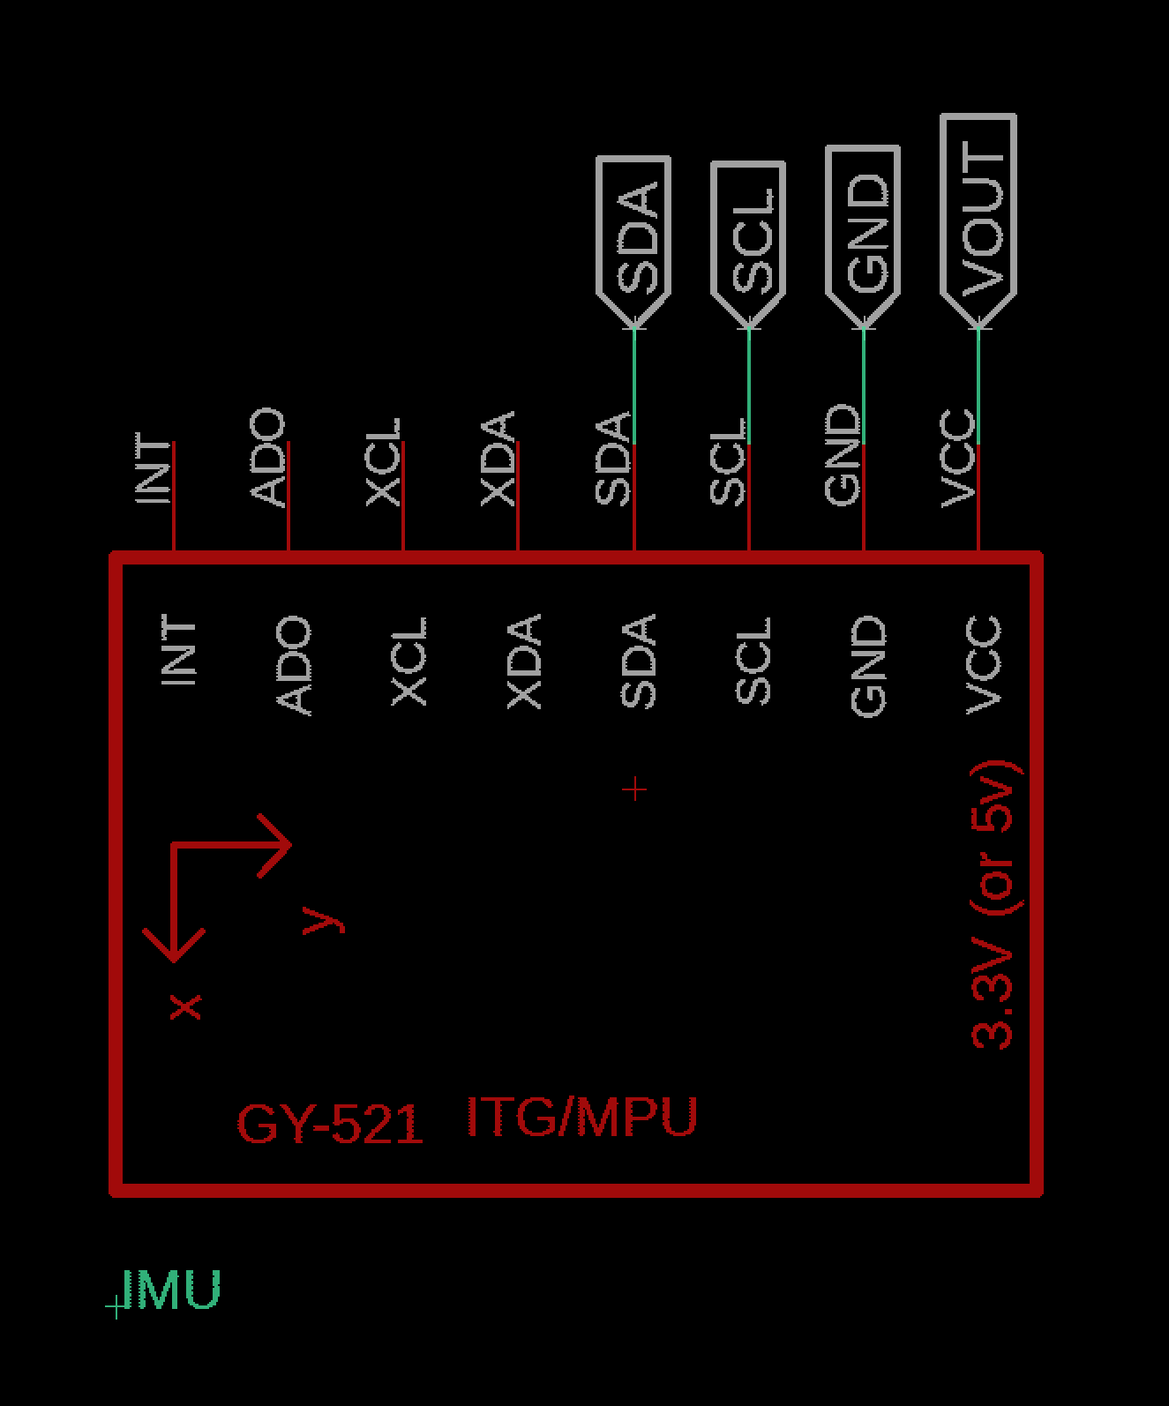
IMU
MPU6050

Slide 7
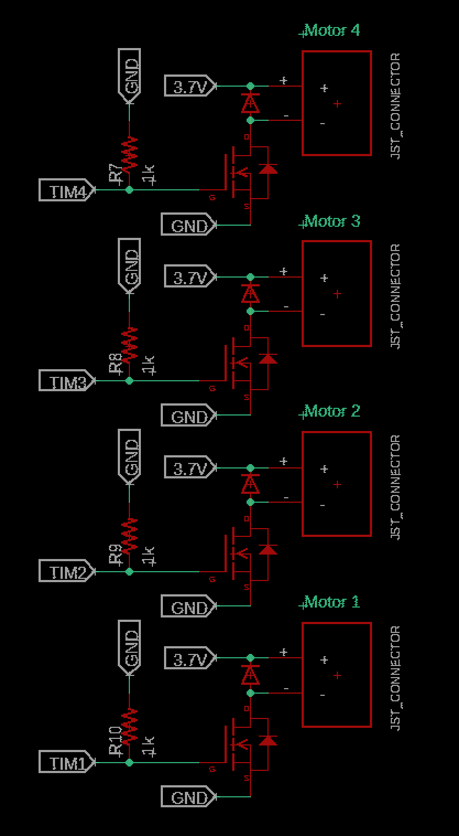
Motor Driver
MOSFET: Infineon IRLML6244TRPBF (x4)
Diode: Panasonic DB2W40300L (x4)
Resistor: 1kOhm (x4)

Slide 8
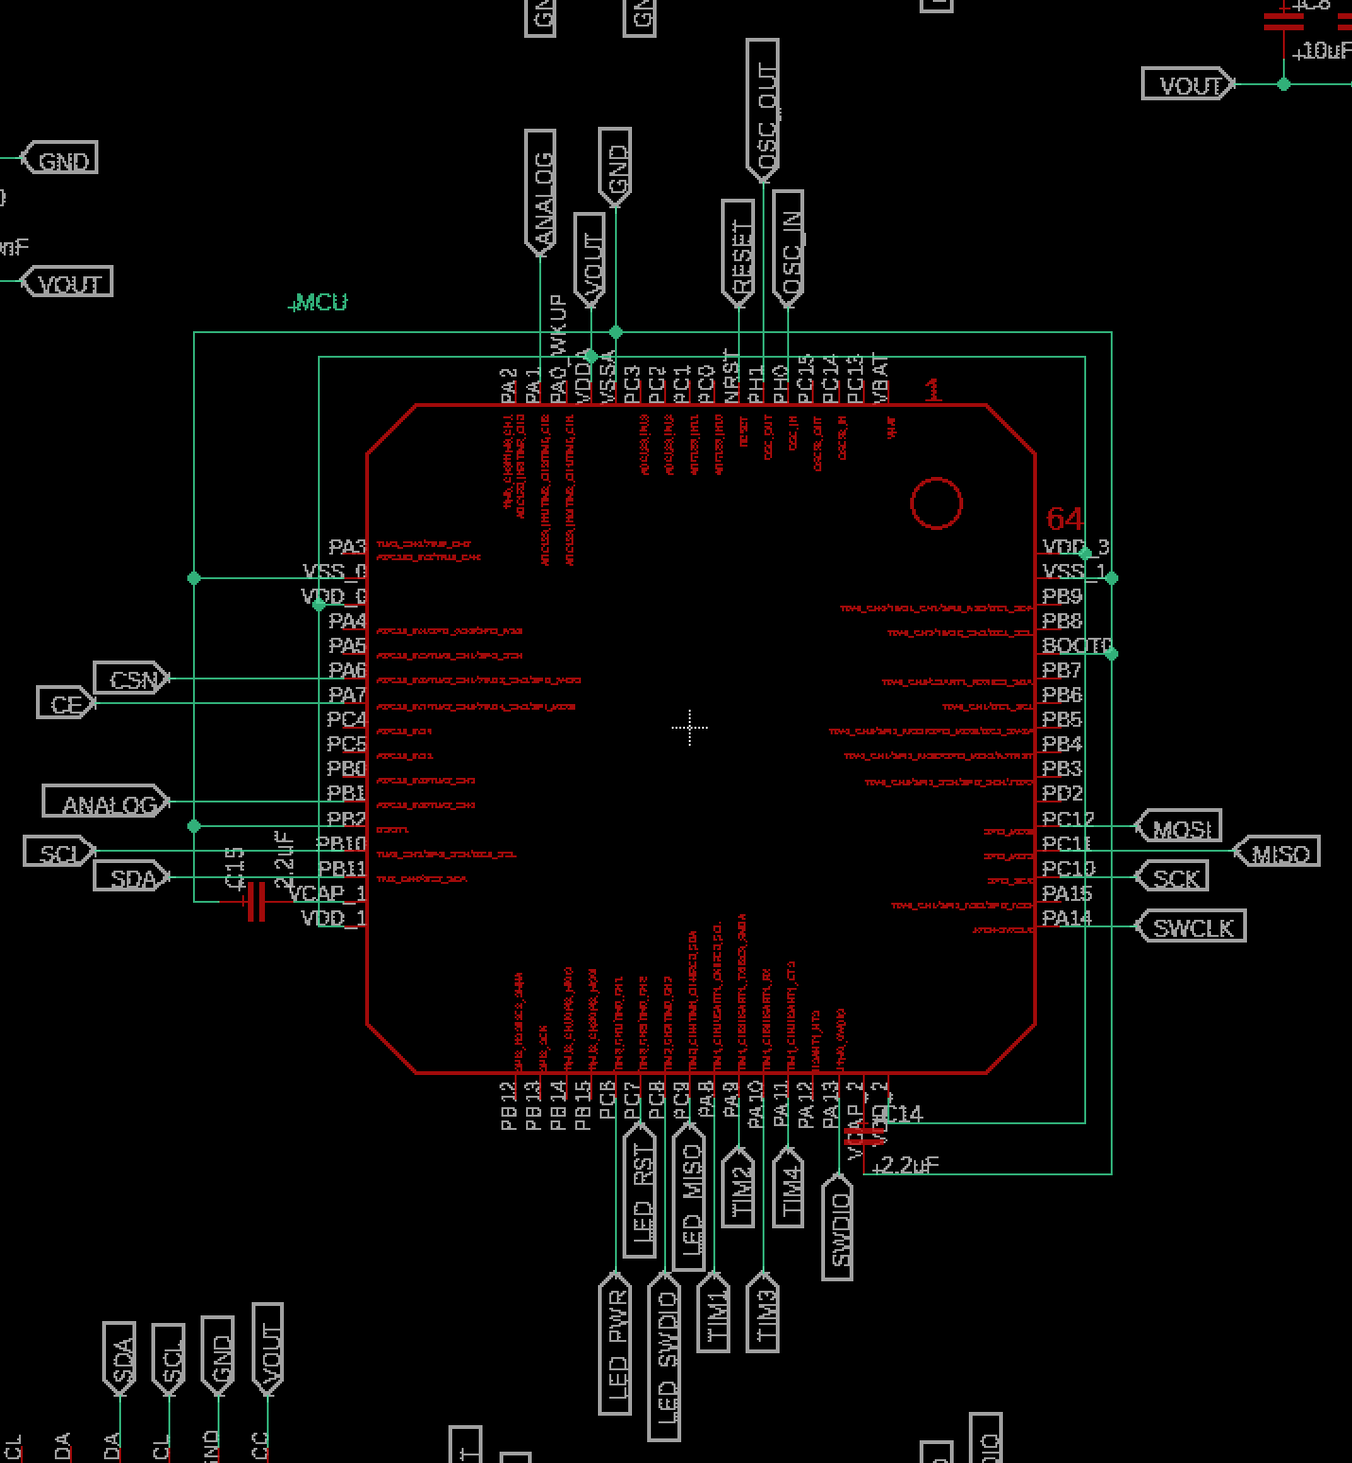
MCU
STM32F405RGT6

Slide 9
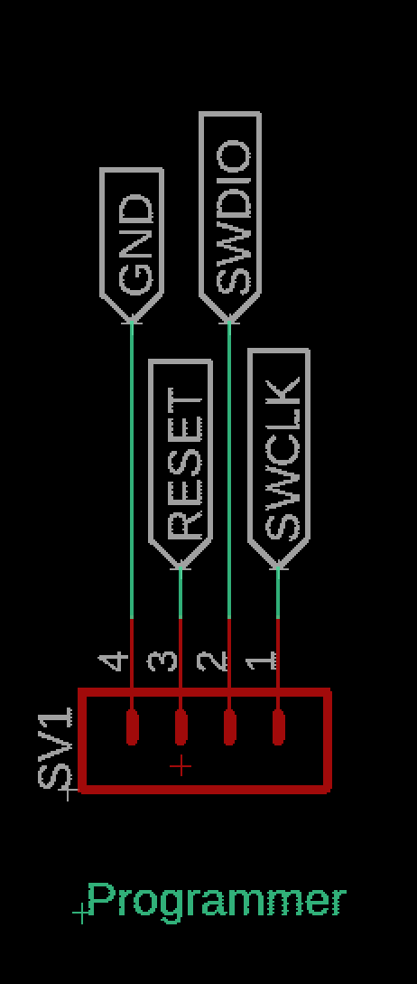
Programmer

Slide 10
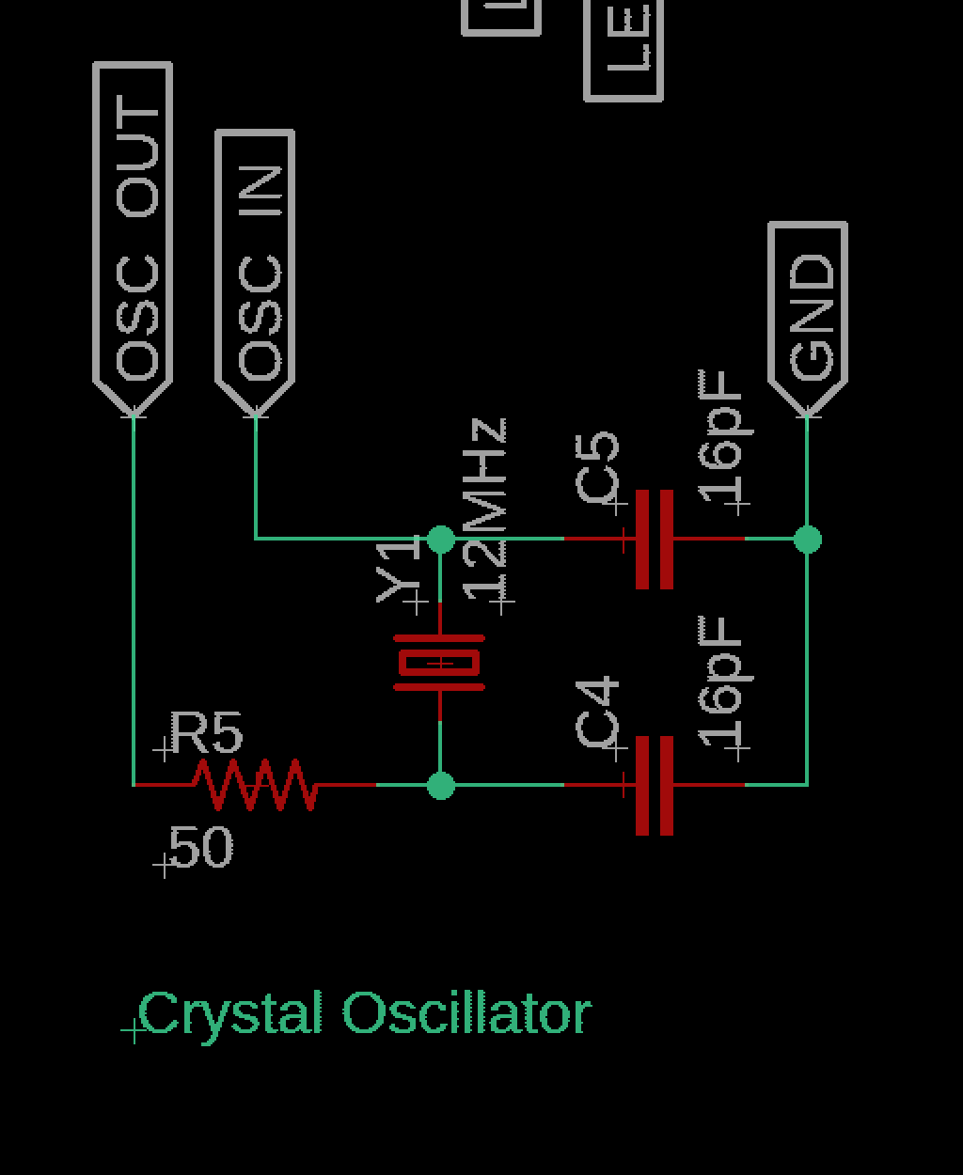
Crystal Oscillator
Abracon ABLS-12.000MHZ-B2-T
Capacitor: 16pF (x2)
Resistor: 50Ohm

Slide 11
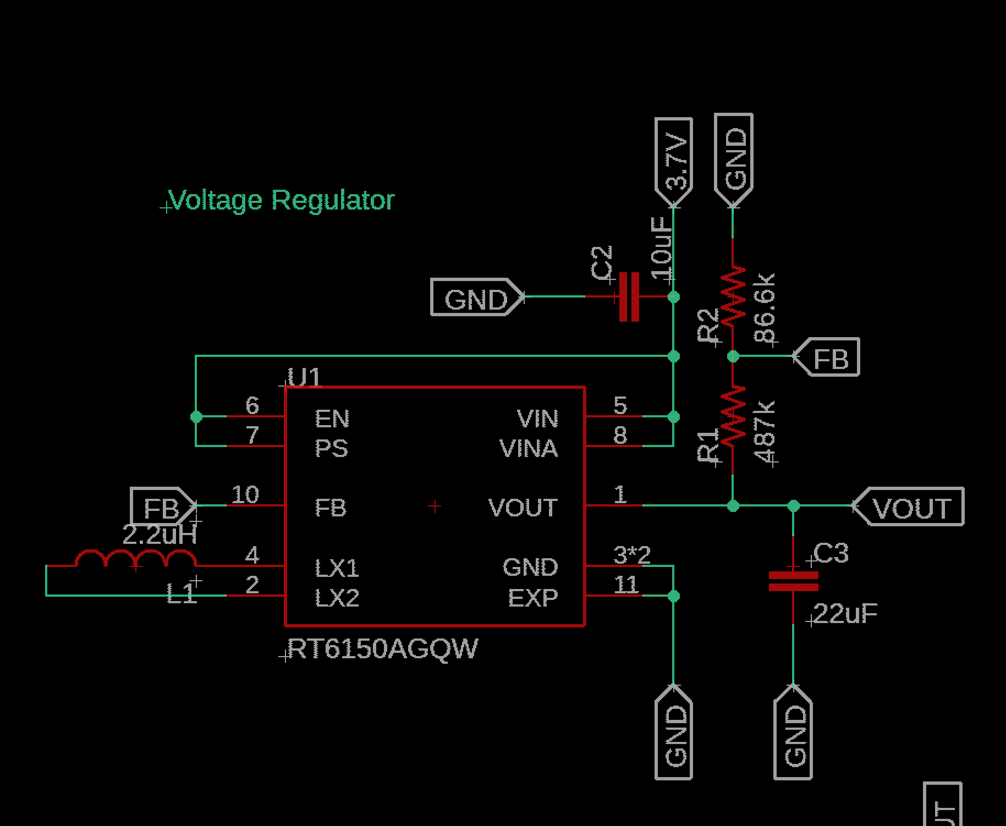
Voltage Regulator
Richtek RT6150BGQW
Resistors: 487kOhm, 86.6kOhm
Capacitors: 22uF
Inductors: 2.2uH

Slide 12
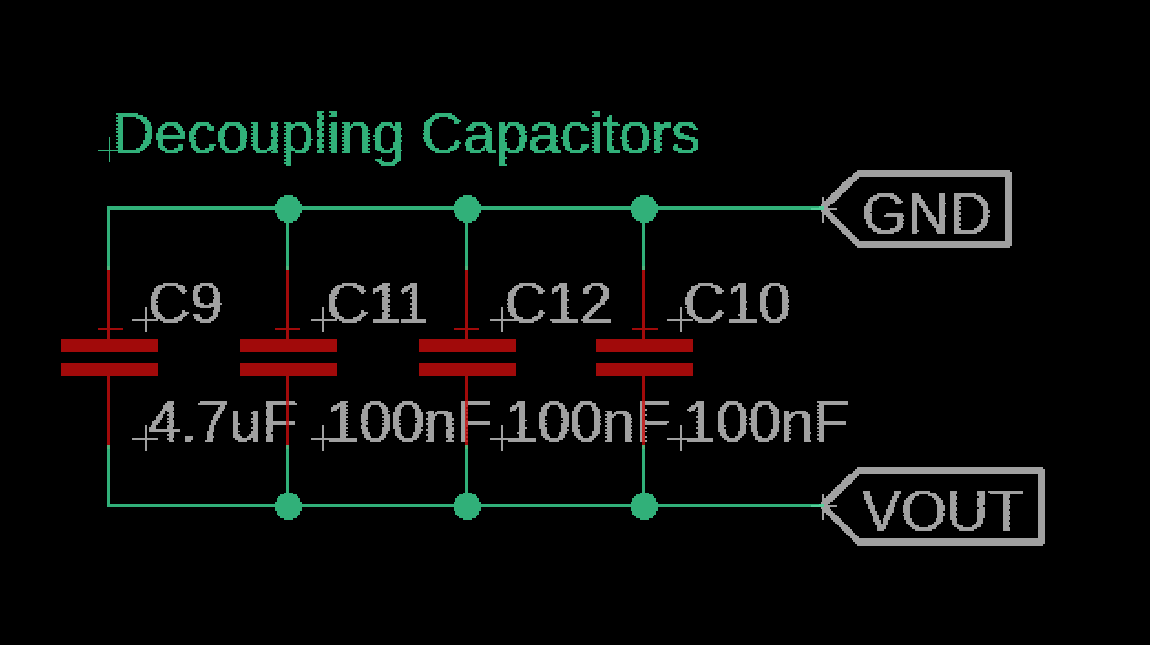
Decoupling Capacitors
NRF24L01p
MCU: 100nF (x3), 4.7uF
Battery: 100uF
Radio: 10uF, 100nF
Voltage Regulator: 22uF

Slide 13
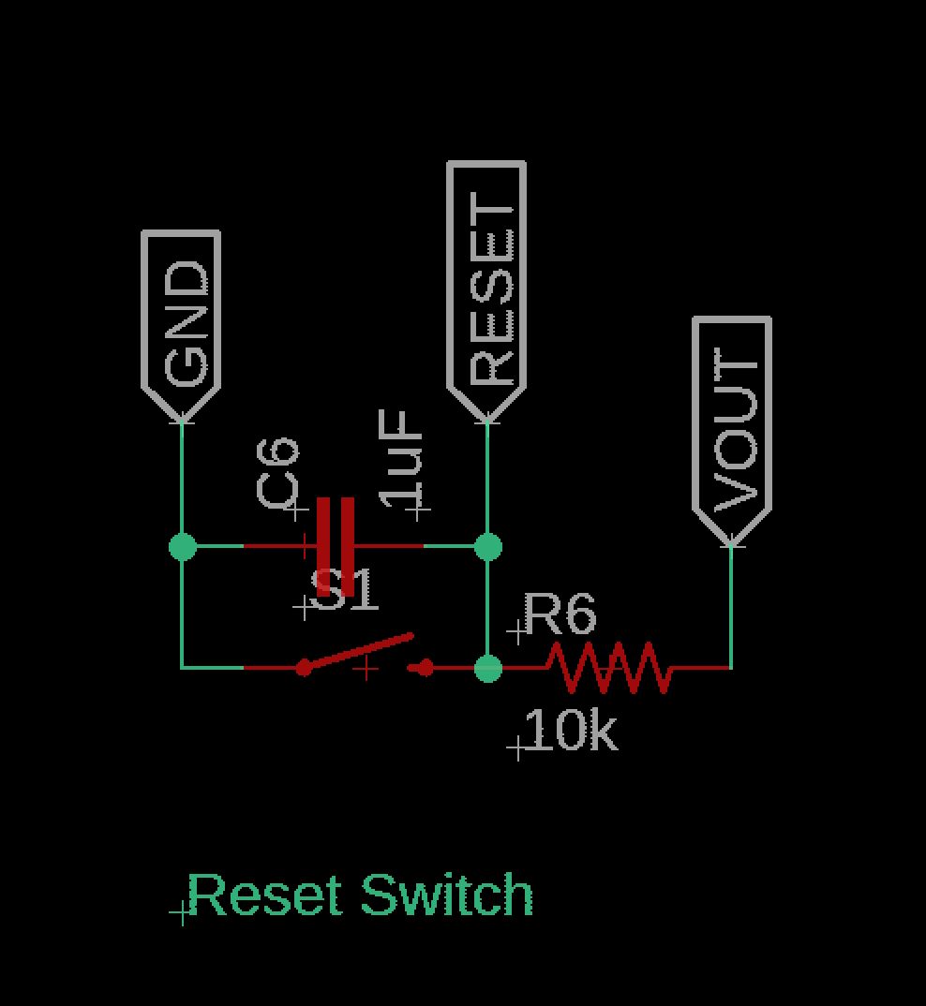
Reset Switch
Resistor: 10kOhm
Capacitor: 1uF

